Slide 1
Practice of Banking
What is Banking Practice:
‘Normal banking practice’ carried on over a
long period of time.
Such normal banking practices carry the sanctity of law and courts do recognize such practices while deciding cases.
Banking Practice---complimentary to law not contradictory.

Slide 2
Some of Banking Practices:
Observing Operational Ethics such as:
Secrecy concerning customer’s affairs:
  Secrecy of Accounts
  Status Enquiries (Exchange of Inter-Bank Credit Reports)

Slide 3
  Banker’s Right of Set-Off:
  Law entitles banks to set-off its claims from customer’s credit balances. However, courts have formulated rules, which require business norms to be followed as well.
  Safe Custody Services (Lockers Facility)
  Governed by the law of bailment. ( Legal relationship of Bailer and Bailee)
  Courts also pay due regard to normal banking practices, while adjudicating cases

Slide 4
Cheque issued with cash as payee
Cash is not a person as such cannot be payee under law.
However, as a matter of ‘normal banking practice’ cheques drawn in referred style are paid by banks to the bearer. Such practice is recognized by the courts of law.

Slide 5
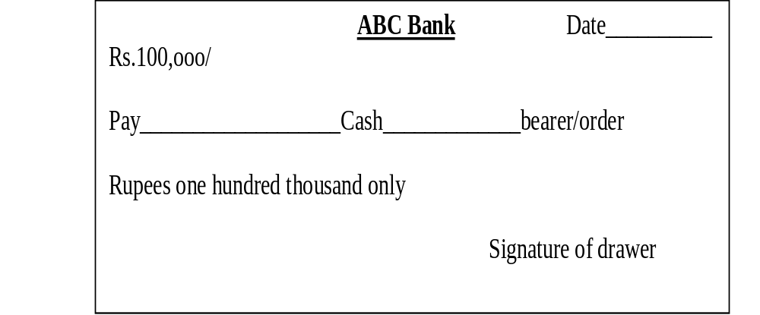

Slide 6
Banking Practice of Closing a Customer’s Account under Following Circumstances:
Frequently drawing cheques without sufficient balance in the drawer’s account.
Depositing cheques for collection which are frequently returned uncollected.
Issue cheques and then issue stop-payment instruction to the bank.
Bank may close account of such customers after issuing reasonable notice.

